Slide 1


University Life: Tips and Tricks from the Experts
Brought to you by:
Your Peer Mentoring Team

Slide 2
Objectives
After today’s session, you should be able to:
Know who to ask for help
Have some ideas as to which extra-curricular activities you will do: - Student Societies - MMU Sports - University Armed Service Units - Science & Engineering Extra-curricular Activities
Plan how to get Awards to showcase your skills to employers - Science & Engineering Extra-curricular Awards - Futures Skills Award

Slide 3
Starter:
Introduce yourself to the person next to you
Write at least one question that you have about Manchester / University life on a post-it
If you have a recommendation about Manchester / University life write this on a different post-it
Hand in post-its to the front - write more as we talk – and we will answer all questions at the end

Slide 4
Student Support
Student Hub
Student Finance
Student Support Officer
Programme Support Tutors
Disability Services
Careers Service
Jobs4Students

Slide 5
Do you know where to get support?
Go to kahoot.it
Type in the PIN on the screen
Type in an appropriate nickname
Answer the quiz questions!
No phone / no WiFi? No problem…
… Work in a pair … Write your answer on paper & hold it up
Notes:
Computer: - Login to getkahoot.com in advance Name (Note capital letters): Peer_Mentors Password: Manchester Quiz: Support Services Review

Slide 6
Balancing your Life
Academic Studies
& Extra-curricular Activities

Slide 7
What are you going to do whilst at university?
Engage with everything to do with your Course: - Learn as much as you can … work as hard as you can - Get the best degree you can (=> Boost employment prospects)
Take part in Extra-curricular Activities: - Fun - Meet people - Learn new skills … without being assessed - Boost your confidence by tackling new challenges => Build skills employers want

Slide 8




Extra-curricular Activities
Student Union - Student Societies - Volunteering - Sports Teams
MMU Sports (Free for all)
University Armed Service Units
Awards - Science & Engineering Extra-curricular Award - Futures Skills Award

Slide 9
What Student Societies do you plan to join?
Student Union:
You have 5 minutes to pick at least one (of each): - Student Society / Sports Club that you have never tried - Volunteering opportunity - Most unusual opportunity
Go to the website: www.theunionmmu.org/opportunities
What did you pick?

Slide 10
What Student Societies do you plan to join?
Student Union: www.theunionmmu.org/opportunities
Additional Facilities: - Table tennis, pool & games consoles - Dance studio - Bar / restaurant / shop → (Can use Metcard!)
Advice Centre: www.theunionmmu.org/advice-centre

Slide 11
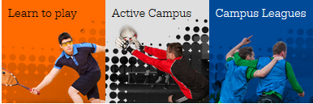
What MMU Sports activities look the most fun?
You have approx. 5 minutes to pick at least TWO activities:
Learn to play
Active Campus
Campus Leagues
UniFit
3 Gyms
Sports Scholarships
Volunteering / Coaching
Go to: www2.mmu.ac.uk/sport
Notes:
After five minutes, ask the bravest in the audience to volunteer what sports they are most interested in and say why

Slide 12
Other Extra-curricular Activities
Leadership & Teamwork: - University Armed Service Units (UOTC / URNU / UAS) - Uprising Leadership Scheme - Leadership Seminar Programme (Wed afternoon – My Career Hub) - Jobs4Students (Student Ambassador, Peer Mentor etc.)
Enterprise & Innovation: - InnoFLUX – Business Competition
Communication: - Student Press Office (Humanity Hallows)
Summer Work Experience: - Industry Visits / International / Research

Slide 13
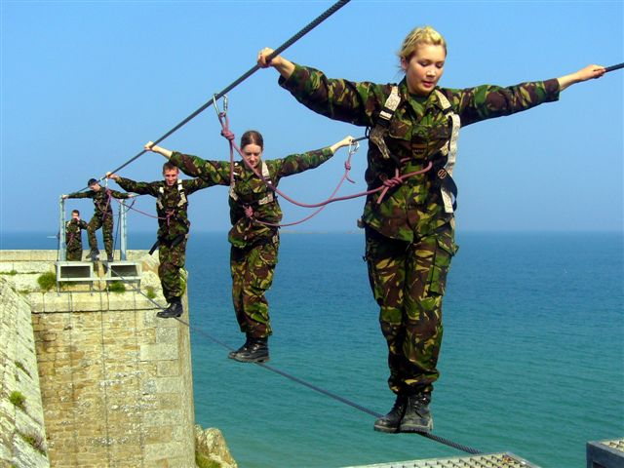
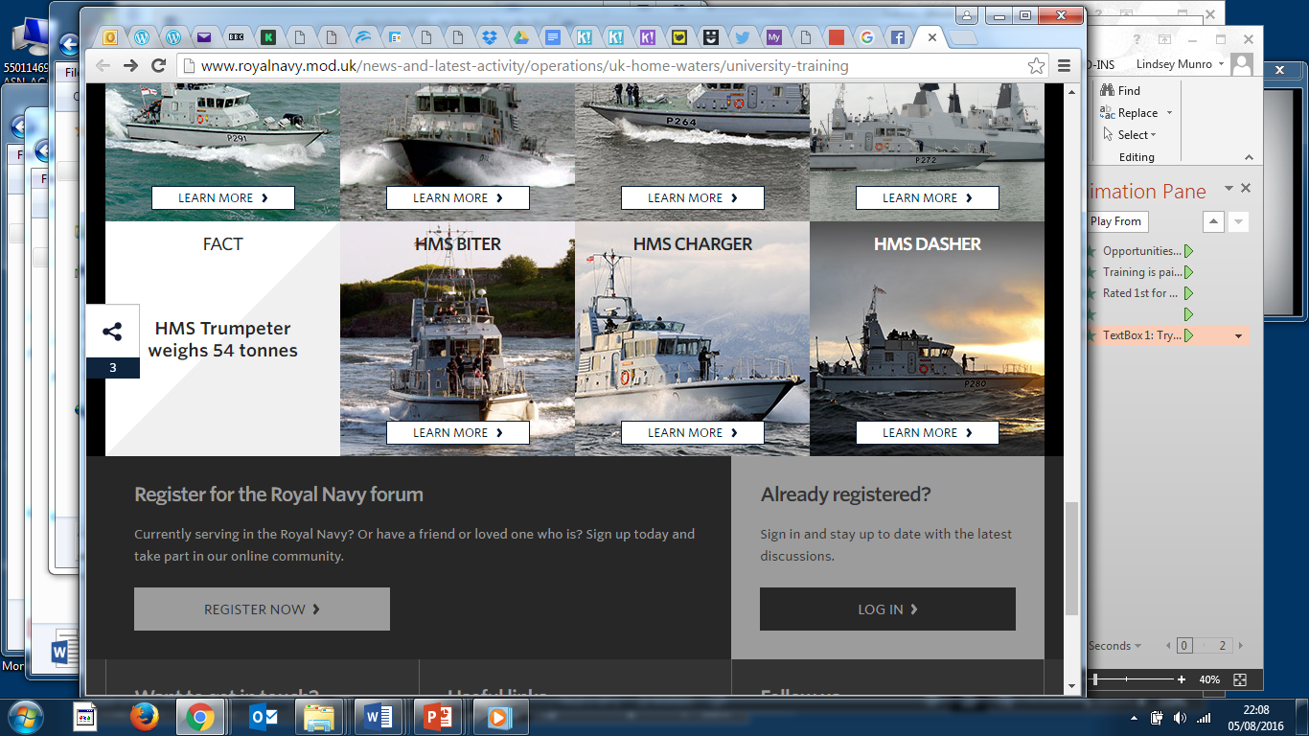
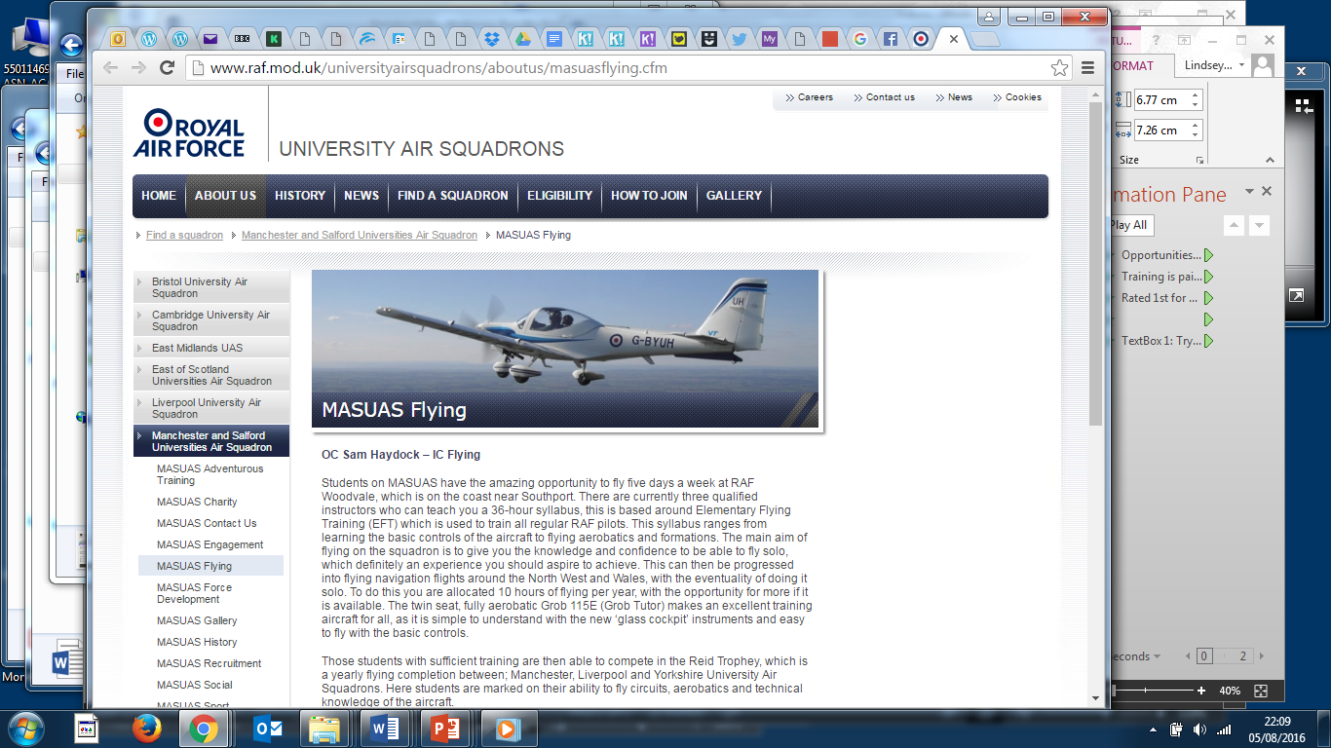
University Armed Service Units
Leadership Opportunities
University Officer Training Corps (UOTC)
University Royal Naval Unit (URNU)
University Air Squadron (UAS)
Opportunities: - Develop leadership potential through military & adventurous training - Earn qualifications (City & Guilds Leadership Award, Sailing etc.) - Play sports - Attend social events
Training is paid
Rated 1st for Range of Useful Graduate Skills gained in a Recent Survey of Employers by University of Manchester

Slide 14
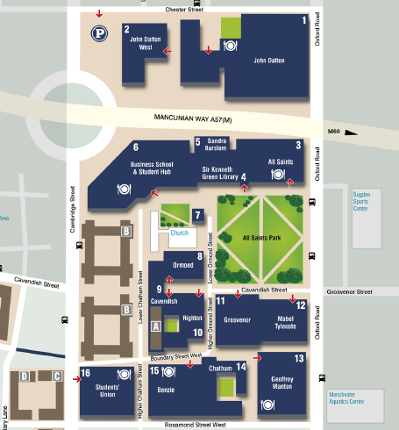
John Dalton Building
Extra-curricular Activities Locations of Key Buildings
Sugden Sports Centre
Armed Service Units
Student Union
Aquatic Centre

Slide 15
Awards
Science & Engineering Extra-Curricular
Futures Skills

Slide 16
Sci & Eng Extra-curricular Award
In the Faculty of Science & Engineering, we run 60+ fun & exciting extra-curricular activities that help you enhance your knowledge of / skills in:
Introductory Taster Sessions
Advanced Technical Skills
Interdisciplinary activities
Employer-led Workshops
Sustainability
The aim is:
Build your skills - Problem-solving Planning & organisation Team work Leadership - Research Skills Communication Adaptability Enterprise
Meet new people
Enhance your CV

Slide 17
Sci & Eng Extra-curricular Award
What? - Complete at least 30 hours of extra-curricular activities run in the Faculty - At least 5 different activities - At least 10 hours of interdisciplinary challenges / of a different subject
Why? For your c.v (fun?)
Who? - All Students at MMU (UG … PG) - Best to complete in Year 1 - Hours will be carried over from year to year
When? Wednesday afternoons + lots for 3 weeks after exams

Slide 18
What Sci & Eng activities would you like to do?
You have ~5 minutes to pick at least 5 activities:
Introductory Taster Sessions
Advanced Technical Skills
Interdisciplinary activities
Employer-led Workshops
Sustainability
Activities: tinyurl.com/sciengaward-activities
Photos: tinyurl.com/sciengaward-photos2017
Notes:
After time is up, allow the most confident students to volunteer their ideas

Slide 19
Futures Friday Activities Fair
Friday 22nd September
11am - 2pm The Street, John Dalton Building
All Science & Engineering Students
FREE ENTRY
Don’t miss out!
Win prizes!
FREE food!
Start earning hours towards your Sci & Eng Extra-curricular Award now!
Fun activities to introduce the future
Faculty of Science & Engineering Extra-curricular Activities Award designed to boost your future career prospects.
Diffusing a Nuclear Reactor, Why are Bananas Bad?, Real-life Cluedo, 200-Year Old Ice Cream, Lemon Helicopter, Fruit Salad DNA, 3D Rollercoaster Simulation, Musical Fruit, Augmented Reality, Raspberry Pi, Academic Society Stalls, Formula Student, MMU Sports, Careers Team, Jobs4Students, UG Research & many more!

Slide 20


How does it work?
Futures Skills Award
www.mmu.ac.uk/futures

Slide 21
What to do in Manchester?
Daytime Activities
Night Life
Perks of Student Life
Transport

Slide 22
What do you recommend?
Daytime Activities
Food
Night Life
Perks of Student Life www.nus.org.uk/en/nus-extra www.studentbeans.com www.myunidays.com
Transport: www.mmu.ac.uk/students/travel
Taxis:
Use licenced taxi firms → black cabs more expensive
Discounts, e.g. Street Cars (10% off)- Call to book (so insured)
Look out for Amazon Black Friday, and Amazon Prime Student!
Check out the Student Lock-in at the Arndale on the 26th September (30% off!)
What do you want to know about?
Notes:
Ask what in particular people would like to find out about

Slide 23
Student Suggestions
Sights & Attractions of Manchester

Slide 24
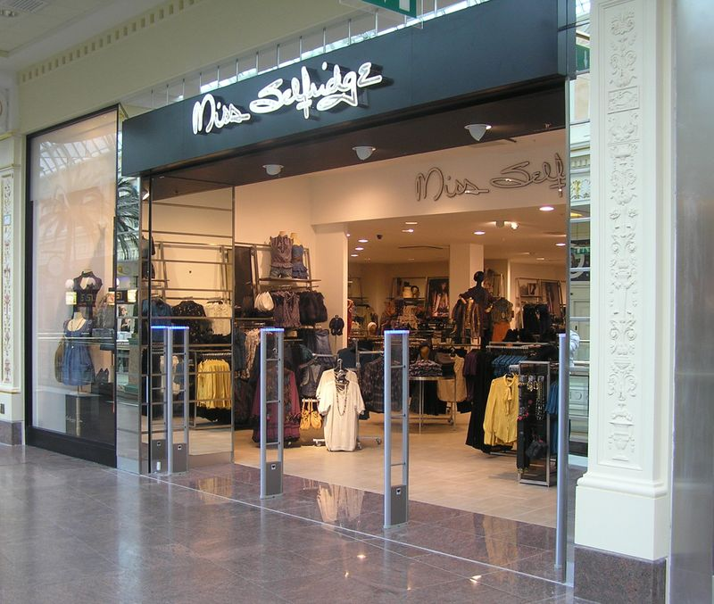
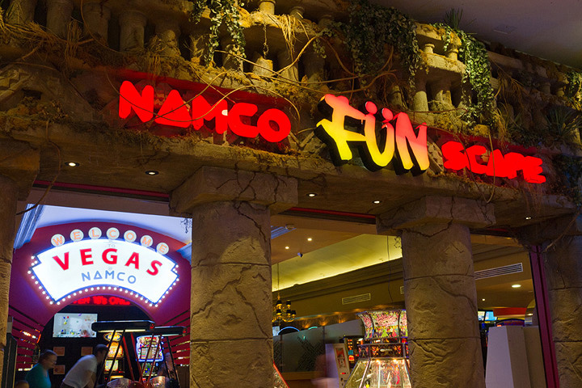
The Intu Trafford Centre
Shopping
Food
Cinema
Drive-in movie
Chill Factor – ski & climb
Trampolines: - Dodgeball / Speed Reaction / Free running / Bear Grylls Fitness
Go-karting
Laser quest
Mini golf
Indoor Sky-diving
Other Shopping centres: The Arndale, Northern Quarter, Lowry Discount Outlet mall (Salford Quays)

Slide 25
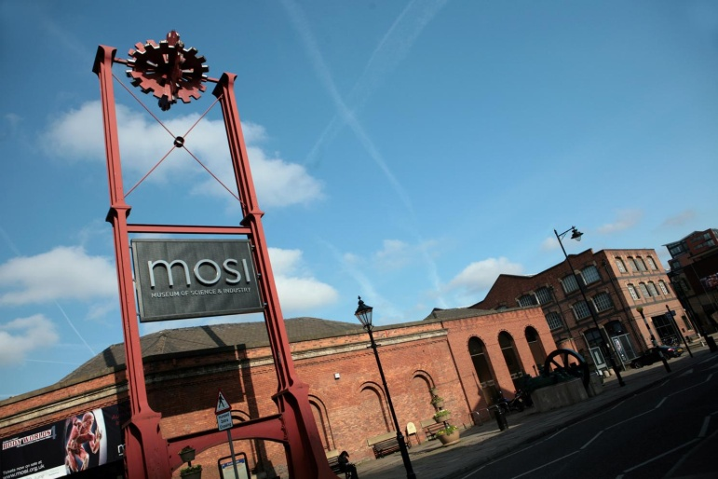
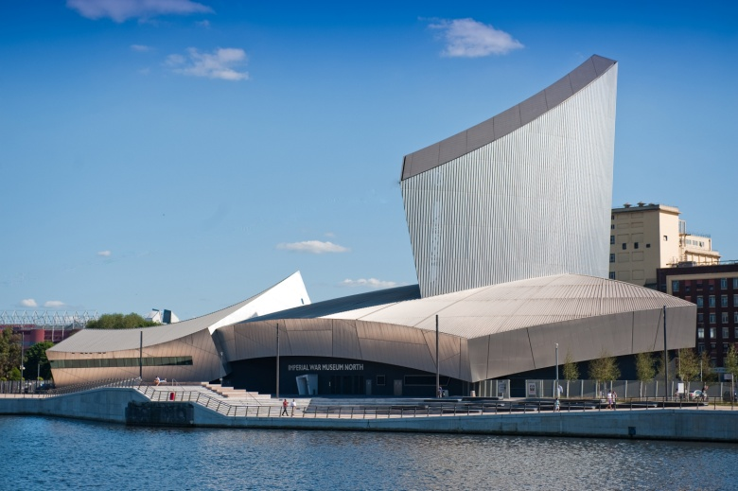
Manchester Museums
Manchester Museum of Science and Industry
Manchester Imperial War Museum
Manchester Art Gallery
National Football Museum
All free!

Slide 26
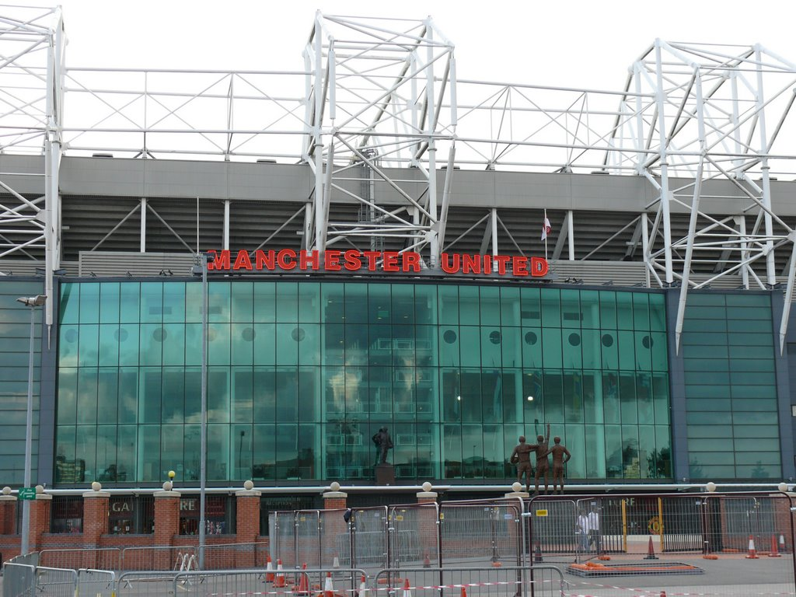
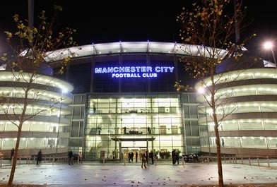
Manchester City vs Manchester United
Stadium Tour and Store

Slide 27
Finance Tips

Slide 28
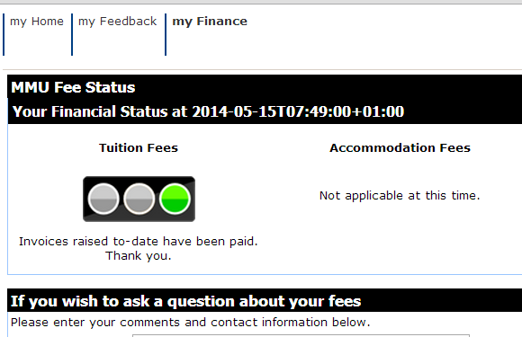
Key Finance Tips
Be proactive:
Make a list of all your expenditure – rent, laundrette, travel, books, printing, birthdays …
Make a budget
Check what support you can get (Go to the Student Hub / online)
Review your finances regularly on myMMU
If you don’t pay your fees, you can lose access to myMMU / Moodle / library / certificates
If you have financial issues:
Don’t do nothing
- Get Help
- Talk to the Student Hub, Finance Team
& Student Union - Note the name of anyone you talk to - If it is taking ages – call Student Finance Complaints line … they have to respond within 15 days

Slide 29
And finally… Are there any questions we haven’t answered from the start?

Slide 30
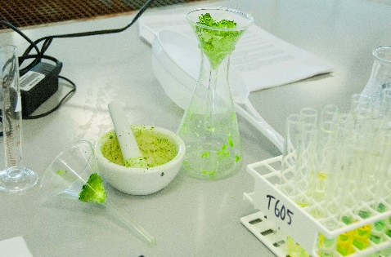
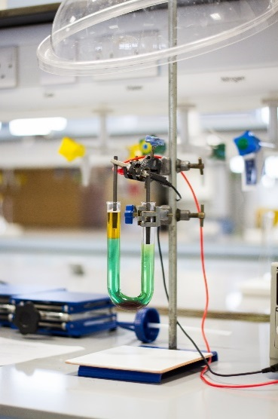
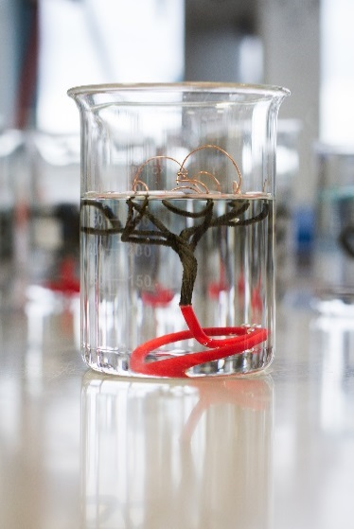
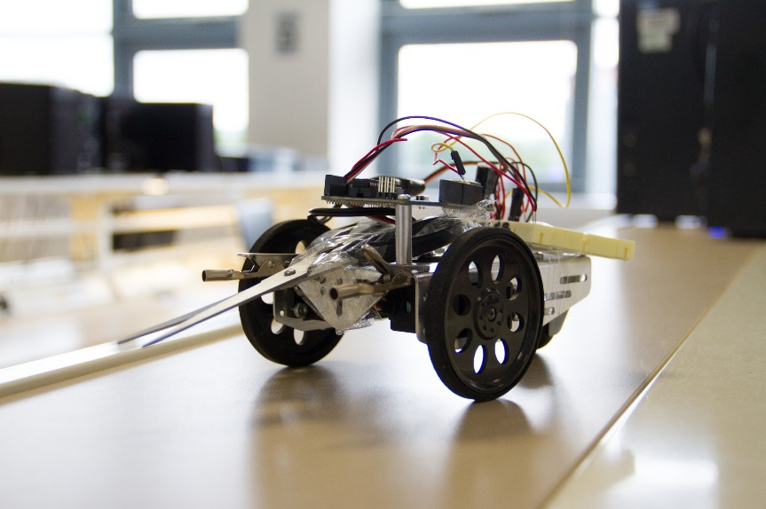
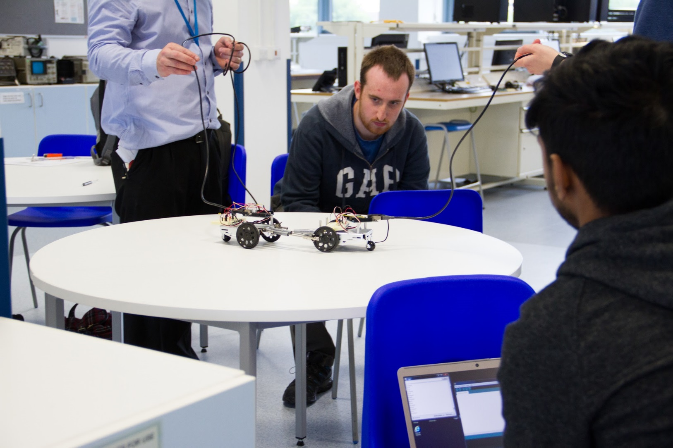
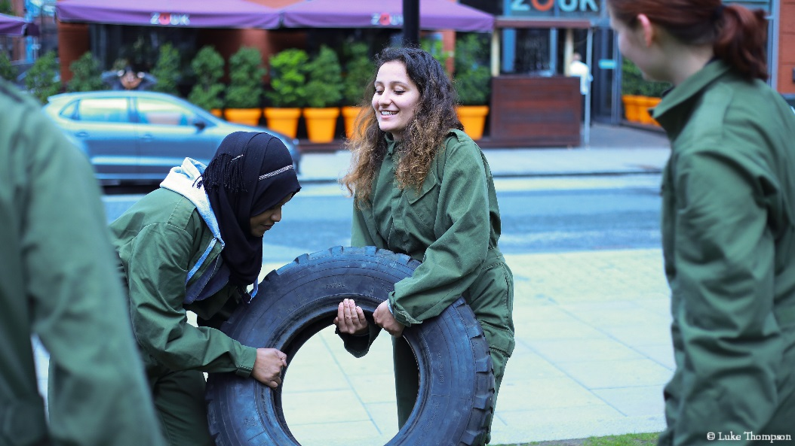

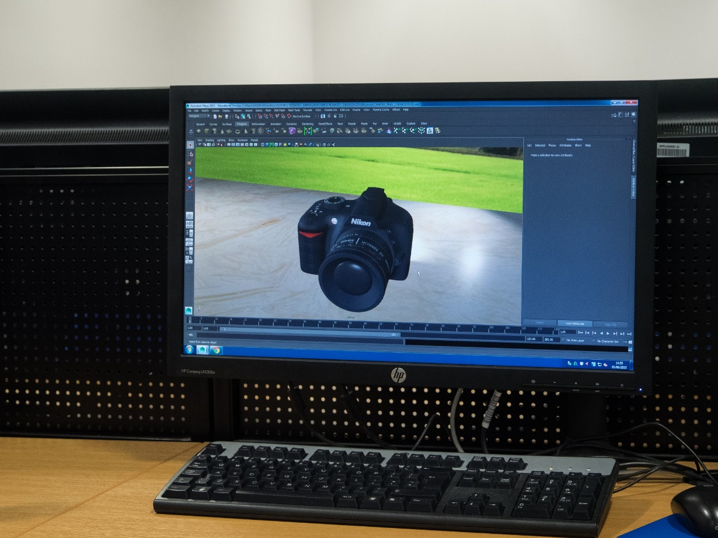
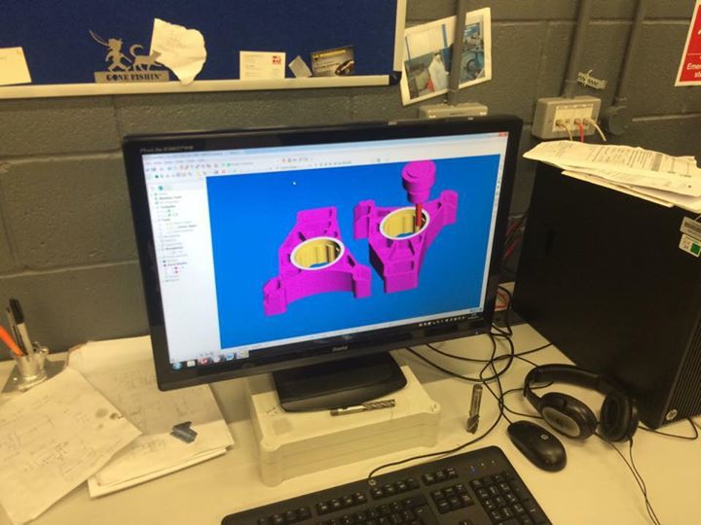
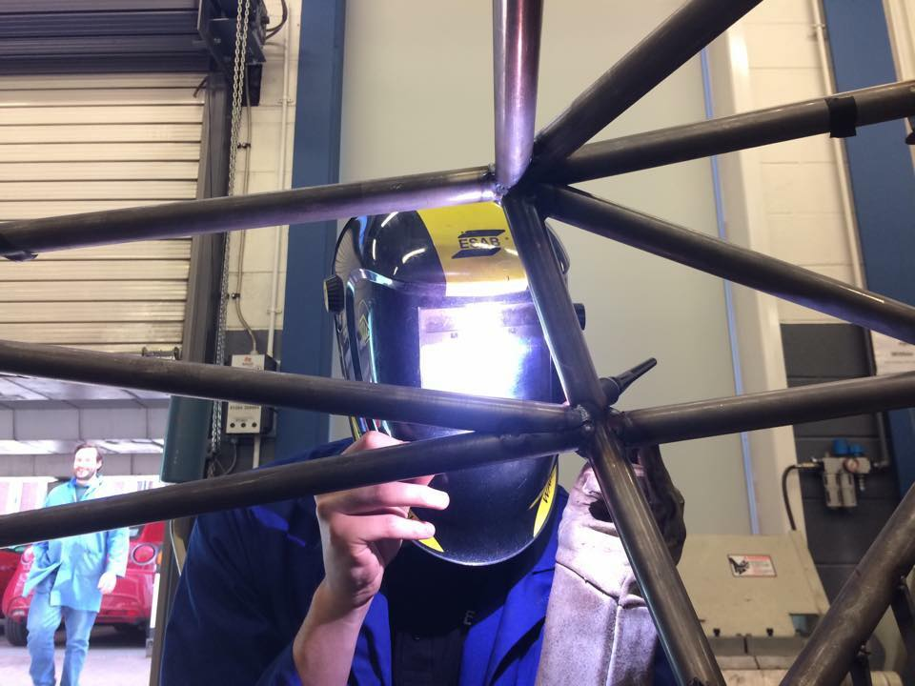
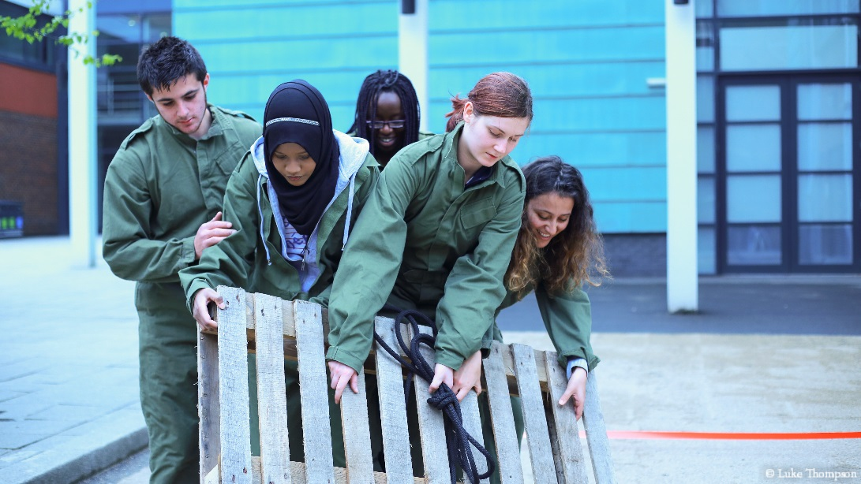
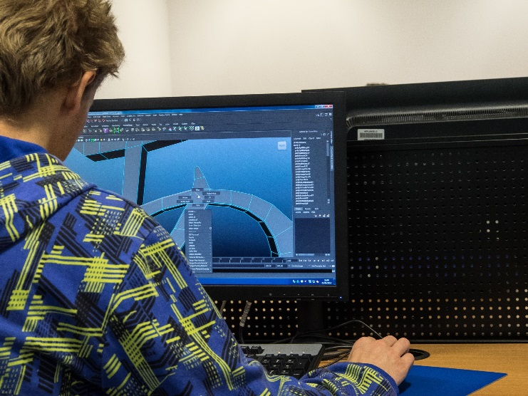
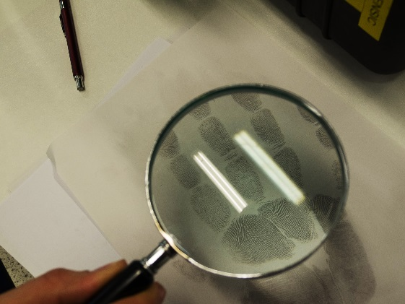

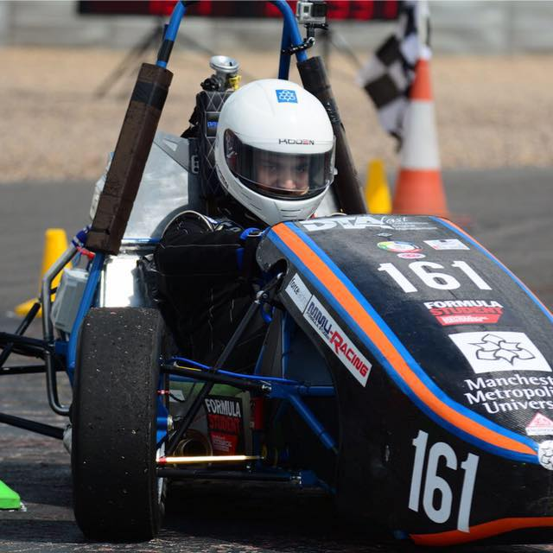
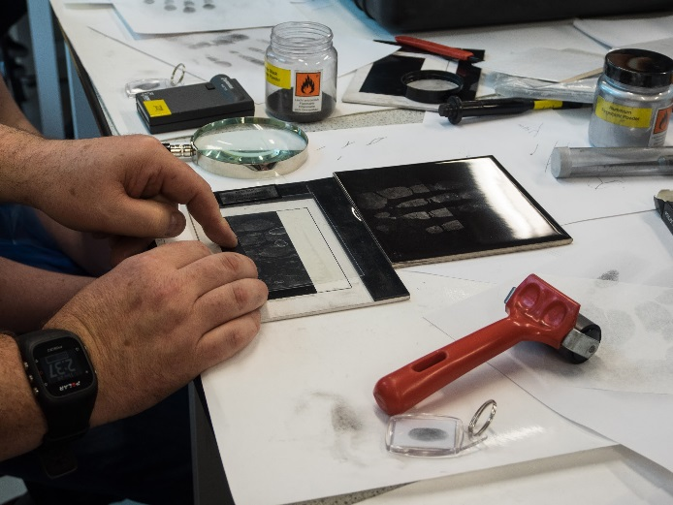
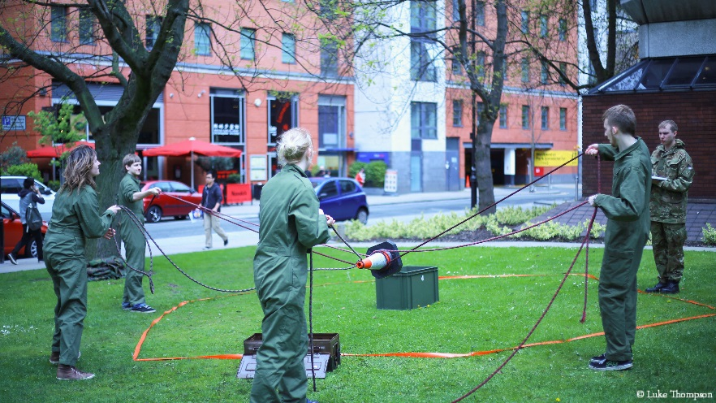
Extra-curricular Activities Get the most out of your time at University
Have fun
… get involved
… make use of the opportunities available whilst at
Manchester Metropolitan University

Slide 31
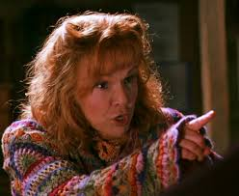

What links Harry Potter with Manchester Metropolitan University?
Hint: Who is Harry’s best friend’s mother?
Diploma in Speech and Drama (Actor)
Mrs. Molly Weasley
Julie Walters

Slide 32


